Slide 1
Software Engineering D7032E Lecture 8: Refactoring
Teacher: Josef Hallberg

Slide 2
Refactoring

Slide 3
Software Re-engineering - Theoretical and Practical Approaches
"Any fool can write code that a computer can understand. Good programmers write code that humans can understand." - Fowler et. al.

Slide 4
Structure of Presentation
Some Theory
Basic knowledge of Re-engineering
Example
How one can use the Theory
Conclusions
Summary
Lessons Learned

Slide 5
Theory
Basic knowledge of Re-engineering

Slide 6
Some Basics
Software Component
Replaced or changed as the system evolves
Individual interface
Encapsulates internal details
Separate documentation
Software Module
Implementation unit
Independently developed
Do not need each other to function

Slide 7
Lehman’s Laws
Program evolution
The Law of Continuing Change
A program that is used in reality must change, or become progressively less useful.
The Law of Increasing Complexity
As a program evolves, it becomes more complex. This will continue until work is done to maintain or reduce the complexity.

Slide 8
What is Re-engineering?
Understand and then improve existing software system
Examination > Analysis > Alteration
Does not change the functionality
Three basic steps:
Reverse engineering
Restructuring/Refactoring
Forward engineering

Slide 9
Why Re-engineering?
Make the system “better”!
More maintainable
Easier to understand
Better performance
Cope with changes outside the system
New software
New hardware

Slide 10
Re-engineering Steps
1. Reverse engineering
Analyze components and their relationships.
Creates a description of the system
The more complex a program is the harder it is to reverse engineer

Slide 11
Re-engineering Steps
2. Refactoring/Restructuring
(x - 1) * (x + 1) = x^2 - 1
Does not change the external behavior
Not same as Rewriting
Rewriting changes the behavior
Improve the design of the code after it has been written

Slide 12
Re-engineering Steps
3. Forward engineering
Move from abstract or high implementation-independent design to a physical implementation of a system
This is the traditional way of designing systems
You know this stuff by now… ;)

Slide 13
Re-engineering: Different levels
Source Code Level
Change structure
Improve algorithms
New language porting
Function Level
Updates to the Class (if OO)
Interface changes (ex Method names)
Architecture Level
Types of components
Interactions between components
Modules

Slide 14
New level needed?
If we fail to understand the architecture of the system
What to do? Can we abstract further?

Slide 15
New level needed?
If we fail to understand the architecture of the system
What to do? Can we abstract further?
New abstraction level: Intentions level
What the system is supposed to do
Abstraction level that captures the essence of the application
Can be seen as a start of a new architecture

Slide 16
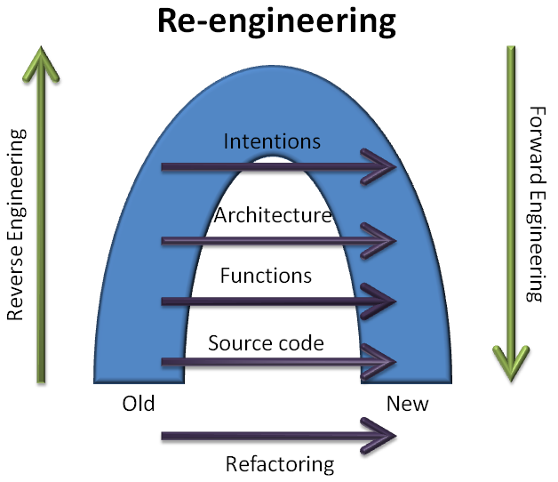
Re-engineering Model

Slide 17
Reverse Engineering: Problems at Architecture Level
Insufficient documentation
Documentation either does not exist or is not up to date
Improper layering
Missing or improper layering decreases portability and adaptability
Lack of modularity
Strong coupling between modules hinders evolution
Duplicated code
It is quick to copy-paste code, but it is really bad for maintenance.
Duplicated functionality
Similar functionality exists in several places of the code.

Slide 18
How to Refactor?

Slide 19
How to Refactor?
Do NOT do it all from scratch!

Slide 20
How to Refactor?
Do NOT do it all from scratch!
Save Time, reuse Knowledge
Use existing Tools and Techniques

Slide 21
How to Refactor?
Do NOT do it all from scratch!
Save Time, reuse Knowledge
Use existing Tools and Techniques
Because key point is to:
Increase cohesion
Decrease coupling
Modularize system parts
Decrease class sizes
Better Class- and Method-names
And so on

Slide 22
Refactor: Existing Knowledge and Tools
Design principles
Fundamentals in software areas
Design Patterns
Reusable software designs
Build on design principles
Frameworks
Skeleton for an application
Many exists in vastly different areas
Often uses existing Design Patterns

Slide 23
Refactor: Different Levels
Different Design Patterns on different levels
Architectural Patterns on higher levels
Can do Refactoring at lower levels
Fowler (see next slide) promotes this

Slide 24
Refactor: Low Levels
Check out Refactoring catalog
http://refactoring.com/
Tons of Refactoring on this site!
Many things really basic IF you know basics, principles and patterns
Example:
You have two classes with similar features
Create a superclass and move the common features to the superclass

Slide 25


Software Framework
Dictates the architecture of an application
Components
Flow of control
Design parameters: what to change
Hot spots
Where developer change
Frozen spots
Hidden from normal development

Slide 26
Real Life Example
One of my student’s Thesis Works

Slide 27
Thesis Purpose
Re-engineer a web application
To follow good system design
Make program source code easier to:
Understand
Update
Expand
Other words: Increase maintainability and understandability

Slide 28

MemoryLane
Life-logging
Digitally record aspects of one's life
Web application
PHP programming language
Review activities
Digitally stored pictures grouped into activities
Support people with dementia
Remember their day

Slide 29

Camera for life-logging

Slide 30
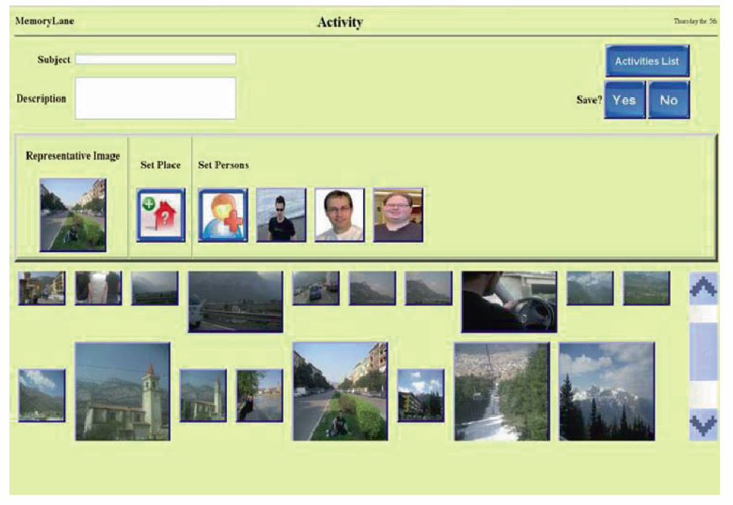
MemoryLane: Create activity

Slide 31
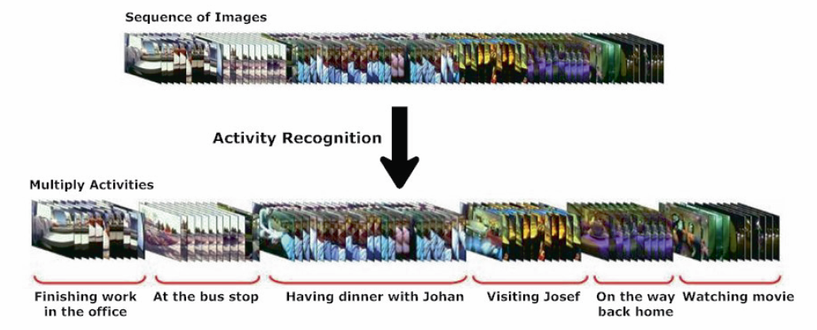
MemoryLane: Activity Recognition

Slide 32

MemoryLane: First looks…
First look on the source code for the MemoryLane application

Slide 33
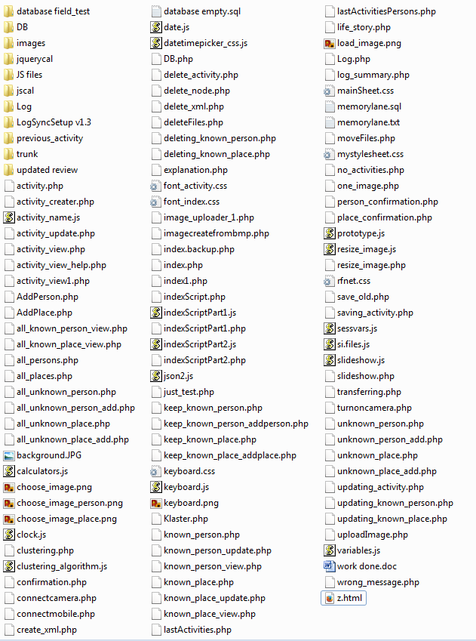

Slide 34
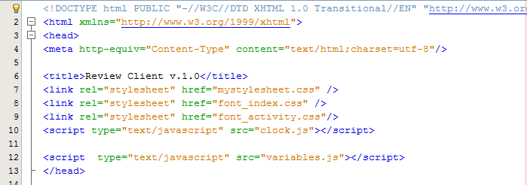

Slide 35
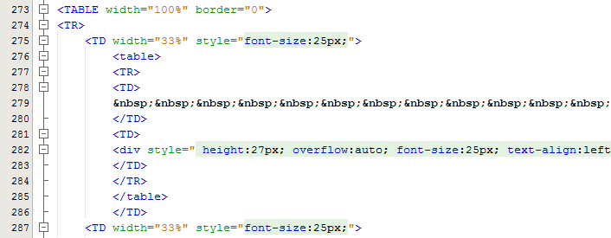

Slide 36
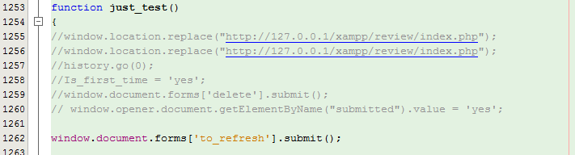

Slide 37
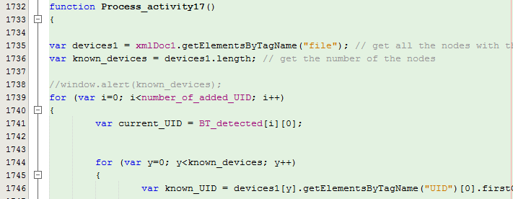

Slide 38
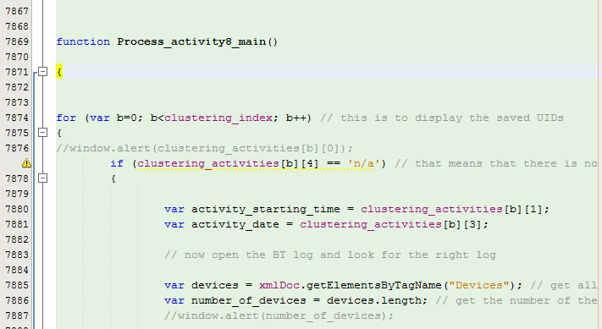

Slide 39
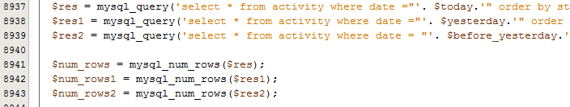

Slide 40
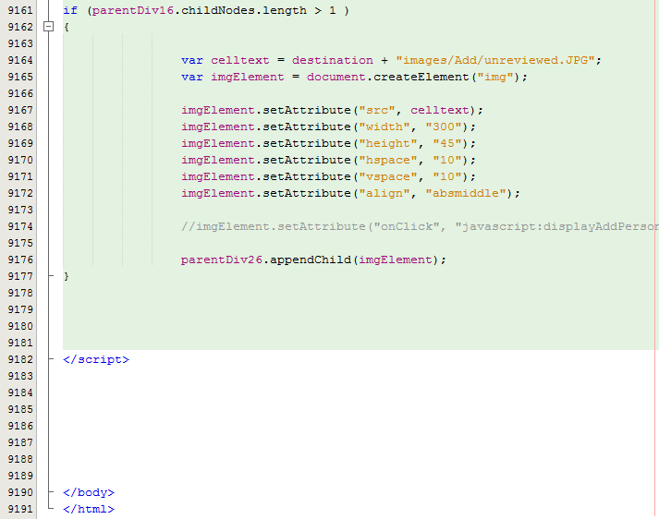

Slide 41
Example Re-engineering
Uh-oh! Alot of problems:
No documentation
No layers
Lack of modularity
Duplicated functionality and code
Example: Database login done in 59 different files.
Very hard to refactor at lower abstraction levels!

Slide 42
Example: Reverse Engineering
Big Bang Approach
Rebuild whole system.
Represent at the Intentions level. How?
Features:
A feature is a realized functional requirement for a system.
It can be seen as an observable behavior of the system that can be triggered by a user.
Can keep external behavior of the system.

Slide 43
Example: Refactoring
Keep functionality intact with features
Refactoring in big steps
Once Big Bang all done:
Refactor my new code in small steps
Can be an iterative process

Slide 44

Example: Forward Engineering
Documentation
Architecture docs.
Design Patterns and Principles
MVC, Separation of Concerns, Dependency Injection, etc…
Build on other’s experience
No duplicated functionality or code
Component based object oriented system through frameworks.

Slide 45


Example: Frameworks
Zend Framework 2 (ZF2): Web Framework
Open source PHP
Object-Oriented
MVC: Different layouts
Modules: Easy to add independent components
Doctrine 2 Object Relational Mapping
Mapping the records of a relational database into the object-instances
Complex to build, easy to use.

Slide 47
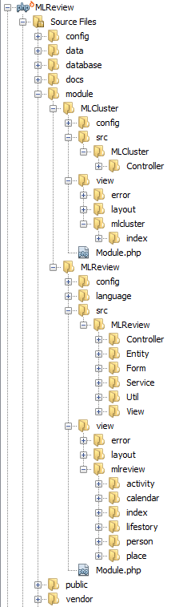

Slide 48
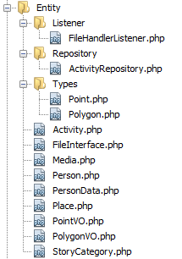
New MemoryLane: Model

Slide 49
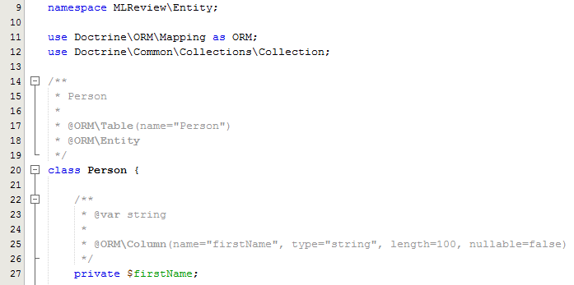
New MemoryLane: Model

Slide 50
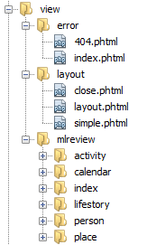
New MemoryLane: View

Slide 51
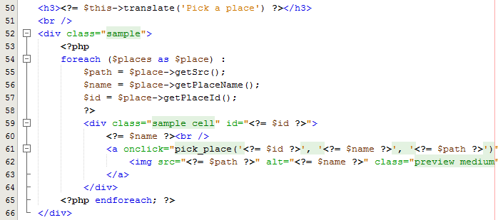
New MemoryLane: View

Slide 52
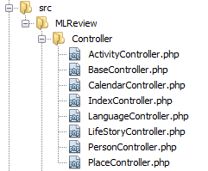
New MemoryLane: Controller

Slide 53
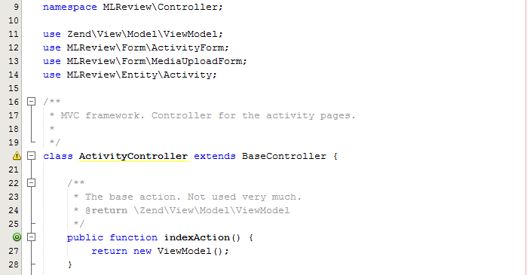
New MemoryLane: Controller

Slide 54
Uh-huh, but is it ”better”?
If we can show that the maintainability and understandability is better, the new application should be better.
From a non-functional re-engineering point of view
Very hard to prove it is better
“It feels better”, might not cut it

Slide 55
Thesis: Code Complexity
Code complexity
Difficulty of maintaining, changing and understanding an application.
Greater complexity => less maintainable and understandable code
Lines of Code (LOC)
Count of lines of source code not including comments or blank lines.
Dependent on programming language.

Slide 56
Thesis: Lines Of Code (LOC)

Slide 57
Thesis: LOC with Frameworks

Slide 58
Since then it has re-engineered again into Django
A lot of administration functionality for free

Slide 59
Conclusions
Summary
Lessons Learned

Slide 60
Summary: Re-engineering
Do not do it from scratch, use:
Existing knowledge
Design Principles
Design Patterns
Existing tools
Frameworks
Techniques

Slide 61
Summary: Working steps
Three basic steps:
Reverse engineering
Restructuring/Refactoring
Forward engineering
Do not be afraid to use your own technique or model!
Needs to fit the project at hand
Example: No Architecture -> Work from Intentions Abstraction Level

Slide 62
Summary: Thesis Example
Transforming the static implementation to an open, modularized, and flexible platform.
Using Re-engineering
Model-View-Controller layering
Frameworks like the Zend Framework 2 and the Doctrine 2 ORM.
Code complexity analysis
New application should have a better understandability and maintainability

Slide 63
Lessons Learned
Build on other’s shoulders
Do not reinvent the wheel
Document important stuff
Comments in code
Later developers will thank you
Conservation of Familiarity
So easy to miss

Slide 64
Lehman’s Laws again…
Conservation of Familiarity
As a system evolves, developers must maintain mastery of its content and behavior to achieve satisfactory evolution.
Without a familiarity of how and why the system was designed in the way it was, it becomes very difficult to implement changes to it without compromising the ability to understand it.

Slide 66
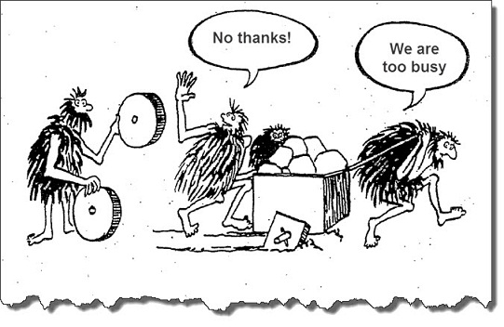

Slide 67
The End
Questions?

Slide 68
Appendix

Slide 69
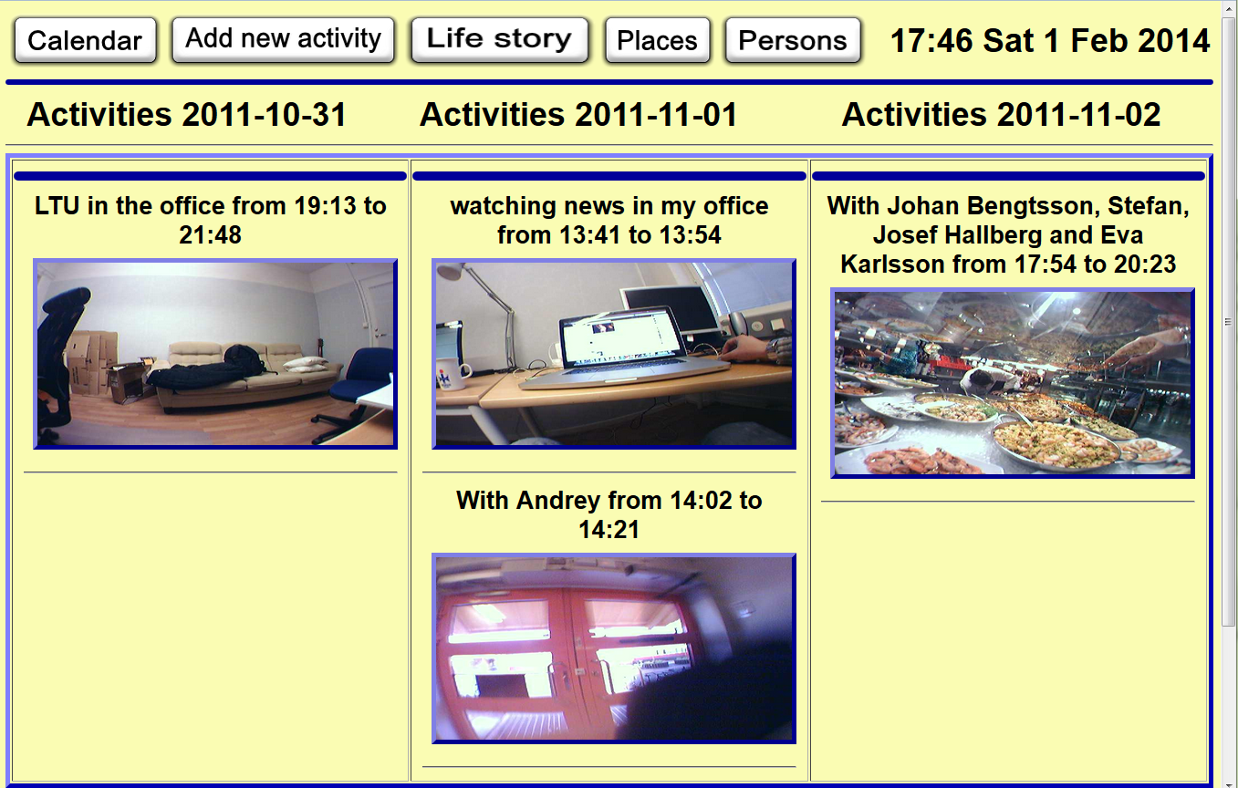
Old prototype

Slide 70
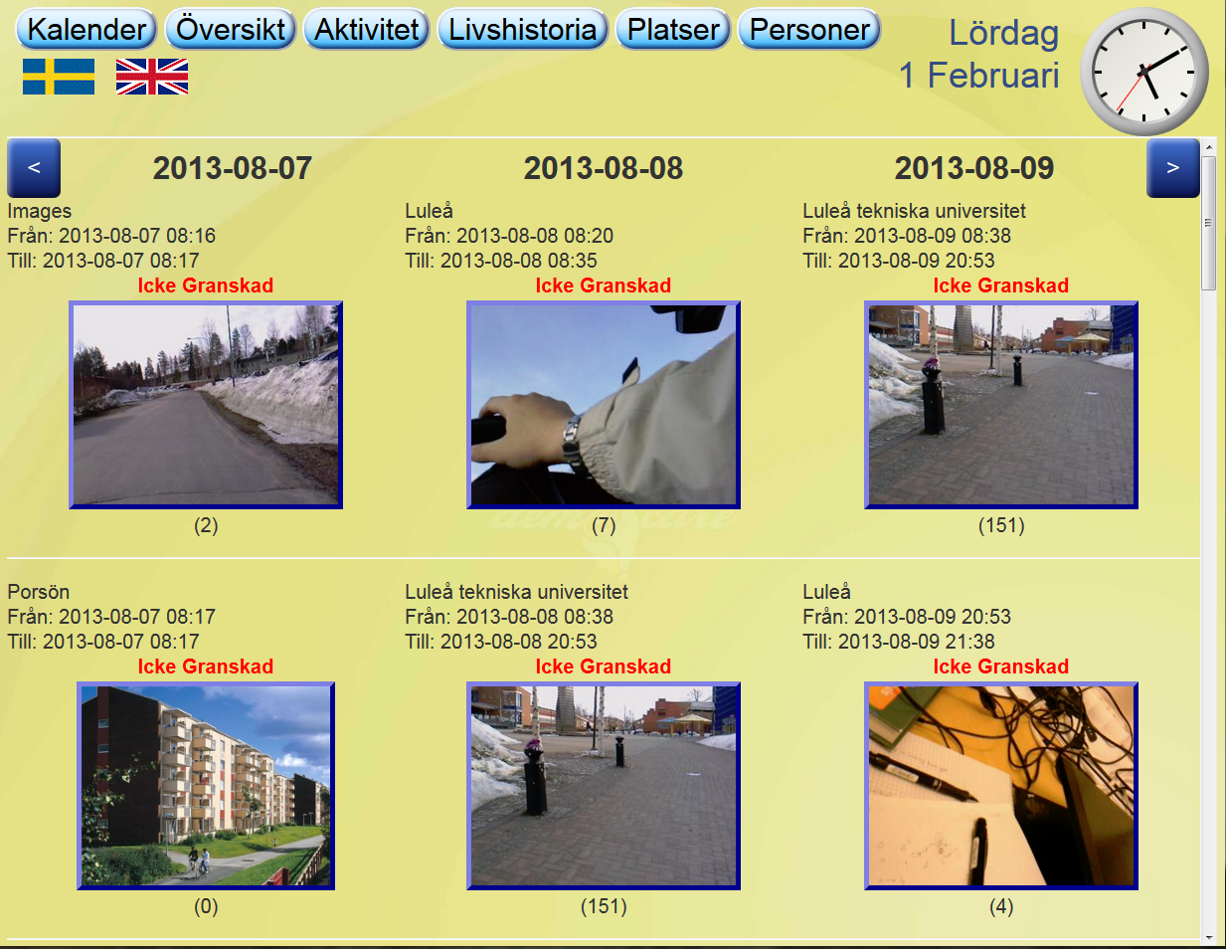
New prototype

Slide 71
OO Design Principles
Single responsibility principle
Open/closed principle
Liskov substitution principle
Interface segregation
Dependency inversion principle

Slide 72
OO Design Principles
Single responsibility principle
A class should have only a single responsibility
Only one potential change in the software's specification should be able to affect the specification of the class
Open/closed principle
Software entities should be open for extension, but closed for modification

Slide 73
OO Design Principles
Liskov substitution principle
Objects in a program should be replaceable with instances of their subtypes without altering the correctness of that program
Interface segregation
Many client-specific interfaces are better than one general-purpose interface

Slide 74
OO Design Principles
Dependency inversion principle
Depend upon Abstractions. Do not depend upon concretions
Dependency injection is one method of following this principle

Slide 75
Example: Design Pattern
Dependency Injection (DI)
Builds on”Inversion of Control”
Design Principle
Also called ”The Hollywood Principle”
Don't call us, we'll call you!
Difference between Framework and Library
Increases Modularity (Design Principle)
Increases Extensibility (Design Principle)

Slide 76
Design Pattern: Dependency Injection
Definition
Dependency Injection: Authoritative component inject any dependencies into other components.

Slide 77
Design Pattern: Dependency Injection
Definition
Dependency Injection: Authoritative component inject any dependencies into other components.
Wait…WHAT??

Slide 78
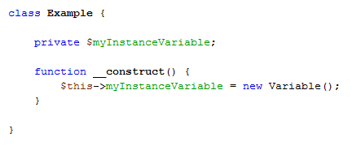
Example Design Pattern: Without Dependency Injection

Slide 79
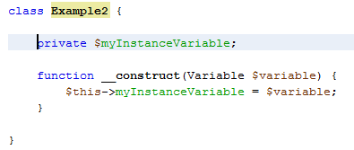
Example Design Pattern: With Dependency Injection

Slide 80
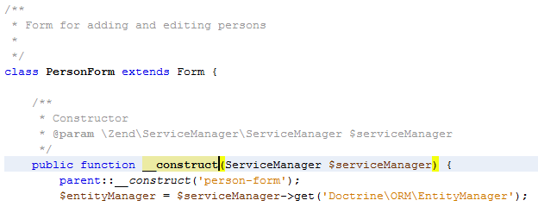
RL Implementation: Service Locator with DI
Service Locator: An object that knows how to get hold of all the services needed by the application.

Slide 81
Questions?

